Slide 1


GÉANT IaaS+ Framework OCRE Launch Event for NRENs and Suppliers
GÉANT Cloud Adoption Support Team
Darko Paric
Task Leader, Cloud Adoption Support
www.geant.org

Slide 2
GÉANT Cloud Adoption Support: Goals
Establish and support the community of NREN Cloud Service Delivery Managers (CSDMs)​.
Stimulate the cloud services adoption ​by the connected institutions and their end users.​
Facilitate outreach and cloud service usage.
Strengthen the NRENs’ national cloud service delivery capabilities, cloud​ competencies, and evolve the NREN cloud service usage skills

Slide 3
Cloud Community
Ca 40 European Countries
Each NREN delegated max 2 contacts as their representatives to the GEANT Cloud Community
Cloud Service Delivery Manager – CSDM

Slide 4
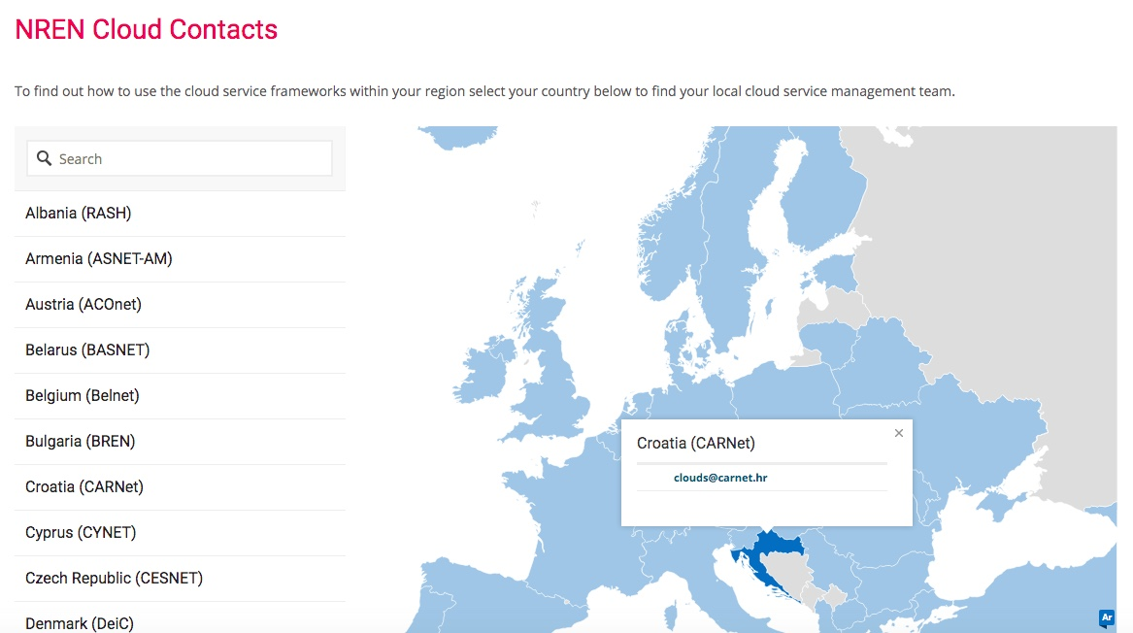
CSDM Contacts
Contacts are published on the GÉANT cloud website

Slide 5
Roles of CSDMs
Liaison between GEANT, NREN and Institutions in country
Part of cloud community
Attending Cloud Forums, trainings, webinars, meetings, events

Slide 6
GÉANT Cloud Adoption Support: Channels
More than 40 NRENs supported
GÉANT cloud website, https://clouds.geant.org/
Managing mailing lists for sharing information and facilitating discussions
Managing internal environments for Cloud Team and NREN Cloud Service Delivery Managers
GÉANT Cloud Helpdesk, clouds@geant.org

Slide 7
GÉANT Cloud Adoption Support: marketing communications
News items and blog posts
Cloud newsletter
Cloud adoption material (user stories, case studies)
FAQ and in-house developed chatbot
Surveys
Tools
Events

Slide 8
Tools for the community
Button
Extracting Framework information from all the tender documentation
Framework selection tools for doing call-offs
Supplier selection tool for direct awarding
Desktop mini-competition tool
Data Classification Sheet
Assists decision making about migrating data to the clouds helping to classify data with respect to security considerations.
Checklists
Cloud security checklist
Other

Slide 9
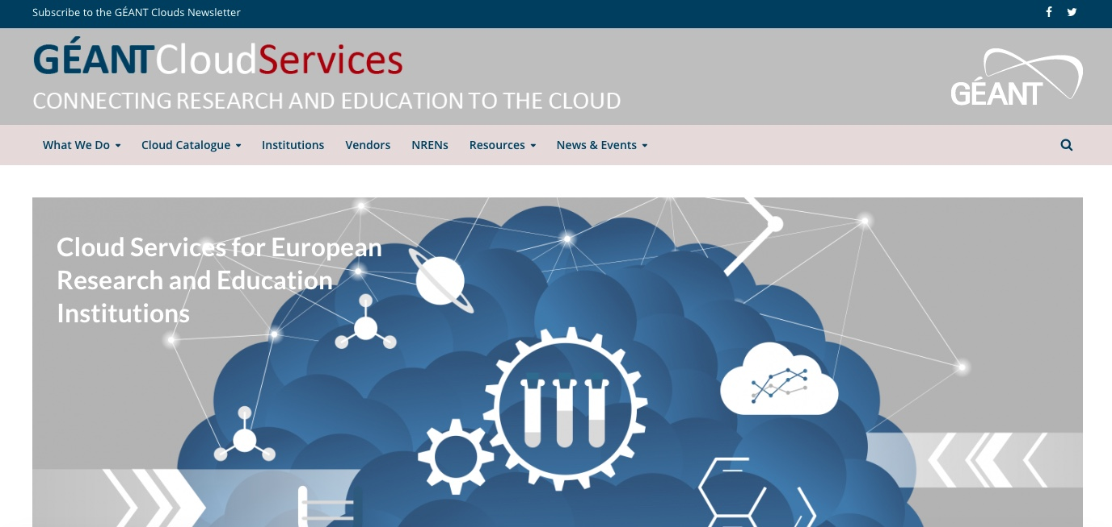
GÉANT cloud website

Slide 10
GÉANT Cloud Helpdesk
CSDMs, NRENs and Institutions have many questions
Topics include services, frameworks, etc
Daily work
A couple of team members behind the Helpdesk

Slide 11
Marketing material
User stories and Case studies
Cloud Strategy Guide for Institutions
Factsheets about products and services
GÉANT 2020 IaaS+ Framework Cookbook

Slide 12
Cloud Blog
Cloud Security blog
Fundamental concepts of cloud security in the context of academia
Security best practices and overview of security services
Cloud Architecture blog
Best practices for building cloud deployments

Slide 13
Frequently Asked Questions
IaaS+ Framework questions collected for NRENs, Cloud Helpdesk and institutions
Knowledge base to support the community
Basis for the IaaS+ Framework chatbot

Slide 14
Event management
Online & face-to-face meetings and events
Pan-European cloud workshops & training​s

Slide 15
GÉANT Cloud Forum
Bi-weekly forums for NREN CSDMs
40 participants as average at the Forums
Discussing technologies, framework, news in community, scaling up problems, etc
Next Forum topic:
GDPR and Shrems II
Rules:
Max 45 min per Forum for all presentations, including Q&A
Present information about the offers that is not publicly available (not sales talk but tailored information for NRENs)

Slide 16
Workshops, trainings
The Adoption Support Team aggregates the NRENs’ demand for IaaS+ Framework trainings.
The Adoption Support Team organiser trainings according NRENs demands.

Slide 17
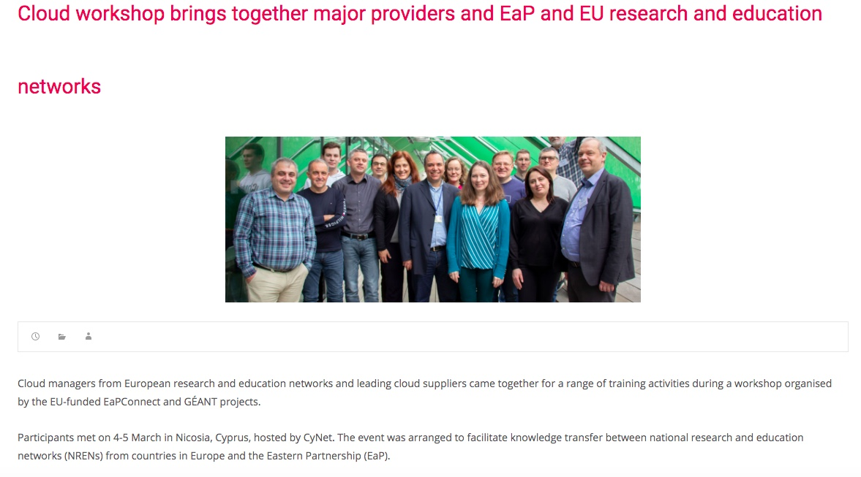
International training, last F2F event before COVID-19
Joint effort by Cloud Support team, AWS, Google and Microsoft

Slide 18
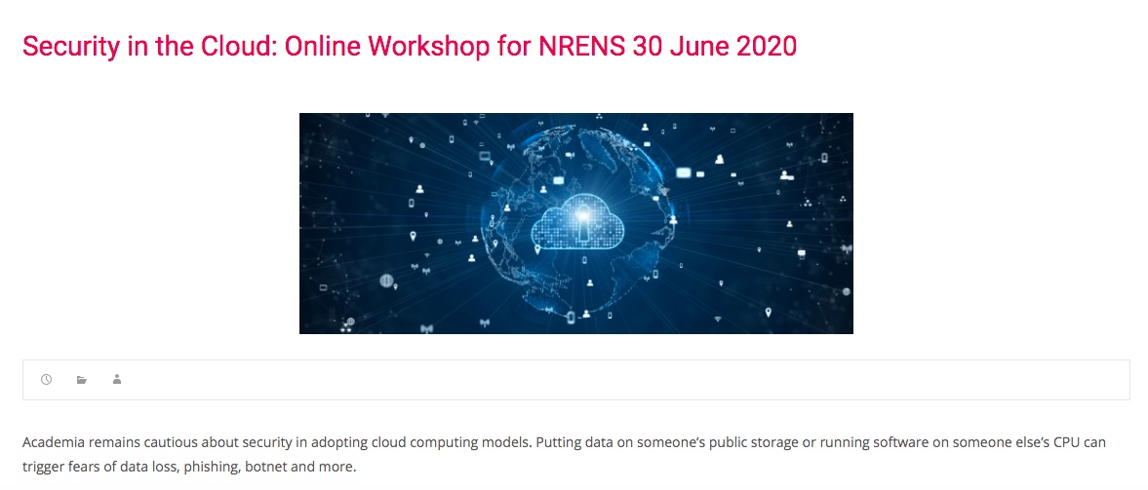
Security in the Cloud: Online Workshop for NRENS
Joint effort of the GÉANT Cloud Adoption Support and Security teams

Slide 19
Cloud Adoption Support Team
Helps the NRENs, Institutions and IaaS+ Framework Suppliers with communication
You can address any of your questions, suggestions or ideas to
clouds@geant.org

Slide 20

Thank you
www.geant.org
© GÉANT Association
As part of the GÉANT 2020 Framework Partnership Agreement (FPA), the project receives funding from the European Union's Horizon 2020 research and innovation programme under Grant Agreement No. 856726 (GN4-3).

