Slide 1

Dave Heyns, Project Director
Adoption Funding
GÉANT OCRE IaaS+ Framework Launch
27 May 2021

Slide 2
Two types of Voucher
Vouchers for individual researchers -
The OCRE project distributed €100K worth of cloud vouchers to researchers in the long tail of science in 2019.
OCRE intends to –
Identify appetite for a second wave of cloud vouchers via various outreach channels.
Also procure vouchers from suppliers of Earth Observation services in support of individual researcher looking to add value to their research outcomes.
Vouchers in support of research projects -
Open calls for funded services
Projects awarded based on impact targets
OCRE External Advisory Board provides oversight
Institutes participate in procurement activities
GÉANT procures specific service credits/vouchers from in-country suppliers used in support of consumption by institute
OCRE comms develops compelling case studies for EOSC portfolio of best practice
€7M

Slide 3
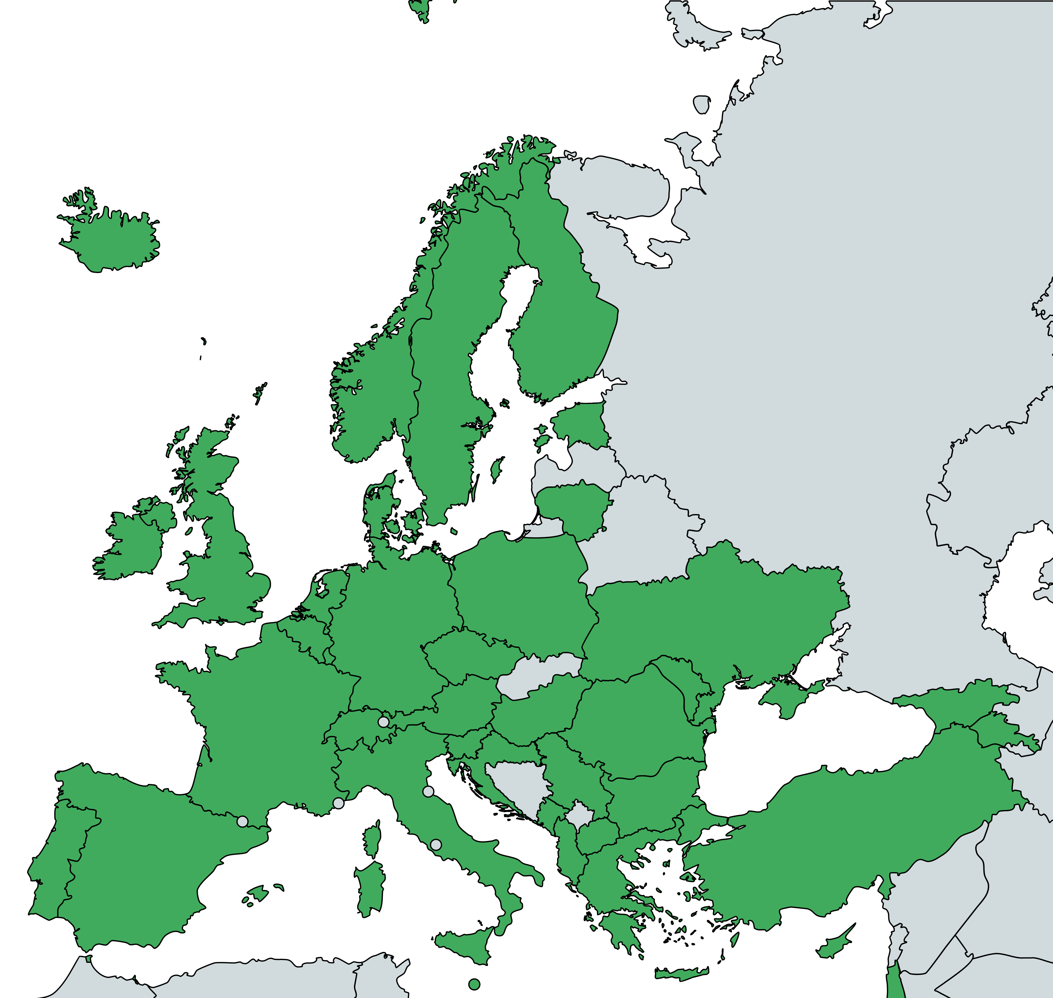
GÉANT CMG
Cloud and EO – Impact targets
Strategy established with OCRE external advisory board
Aim for bigger, research-relevant projects that really show the research community how OCRE's portfolio of services can help to achieve great research outcomes, e.g.
  Intend on consuming cloud and digital services to accelerate research outcomes
  Are able to demonstrate the impact of these services in terms of their outputs and agility
  Are not currently using these tools at scale
  Provide significant relevance in terms of their research discipline
  Form part of the broader European research community
  Hope to support further research and collaboration through their efforts
  Look to begin consuming services at year end 2020 or early 2021
  Identify opportunities for hosting of FAIR data
Inspiring showcases
case studies which inspire other researchers to adopt infrastructure-cloud services for their research

Slide 4




GÉANT CMG
Funding – Calls (research projects)
First call published on September 15th, 2020
Focused on project submissions by individual institutes (Wave 2)
Meet impact targets as described earlier
Broad in terms of reach (Discipline and location)
Signed off on by EAB
Socialised across all channels available to the project
Will provide precedent for future calls
First call will exclude opportunities for Buyer Groups
First call published on October 15th, 2020
Focused on project submissions by individual institutes (Wave 2)
Meet impact targets as described earlier
Require digital services consuming COPERNICUS data
Are able to clearly describe these service in support of publication (DPS)
Signed off on by EAB
Socialised across all channels available to the project
Research response to first call – 32 proposals
Award – 15 proposals @ €1.2M
Research response to first EO call – 25 proposals
Award – 6 proposals
i
i

Slide 5



GÉANT CMG
OCRE Funding calls - CLOUD
I
R
R
R
R
R
Researcher
Oncological PET Data in Treatment Response Prediction
Galactic Research in Cloud Services
Human-Machine Collaboration on Perception Tasks
Rapid Discovery of Thermoelectric Clathrates
DigiFarm | From crop to cloud (Big Data And Machine Learning)
Large scale brain network analysis
Agile HPC for Undergraduate Research
CVL Health Diagnosis from Mobile Phones
Sychrotron light experiments
CVL Multi-task learning
Automatic detection of potential contradictions in the text of acts of law
Fast Ozone Profile Reprocessing
Molecule classification using visualization and convolutional neural network
Cognitive Power Electronics
Belgium
Germany
Hungary
Israel
Italy
Netherlands
Norway
Poland
Serbia
Spain
Switzerland
United Kingdom
€

Slide 6
GÉANT CMG
Funding – Next steps
VAT (voucher) complexities -
GÉANT (NL) procures vouchers
VAT charged by supplier in country where service is delivered
Potential dual taxation
  Applied to Dutch tax authority for exemption ruling (imminent)
  Without which the cost would not be compliant with the OCRE grant
Preparing mini-competitions for 4 projects
testing procurement approach
expect mini-competition in June; 2xNL + 1 Spain + 1 Italy
Test mini-competition process and gain experience
Execute remaining (11) mini-competitions for cloud projects (and get the 6 Earth Observation projects on their way too)
Devise plan ahead for remaining adoption funding for projects
  Establish revised strategy with the EAB
  Establish new timeline for call
  OCRE extended with 6 months
TNC 2021 presentation "Observations on use of commercial cloud services by researchers"
  Wed 23 June 10:00-10:40
  https://tnc21.geant.org/

Slide 7
Thank you
Please refer any questions to:
clouds.servicedesk@cloudteam.geant.org

