Slide 1

Dave Heyns, Project Director
OCRE in a Nutshell
GÉANT OCRE IaaS+ Framework Launch
27 May 2021

Slide 2
Europe is the largest producer of research data in the world.
The EC wants to increase the use of this data and interconnect research IT infrastructures through the European Open Science Cloud.
OCRE intends to –
Provide European R&E community with access to commercial cloud and digital services.
Drive the adoption of such services and stimulate the European digital economy
Promote agility in local research activities (harness analytics platforms; machine learning; AI)
Support collaboration (both regional and global)
Drive broader EOSC ambitions (OPEN research; FAIR data; stimulation of SME development; sustainability)
Stimulate European digital economy
Grow emerging earth observation digital solutions (DIAS)
Provide for acquisition and service discovery (onboard onto EOSC-hub)

Slide 3





GÉANT CMG The OCRE IaaS+ framework
Compliance
Platform tested using HNSciCloud workload
All suppliers bound by GDPR regulations
In-country support and call-off
Networks
Peering POPs under review (GÉANT)
Data ingress/egress waivers in place
Cloud Interconnect/Expressroute/Direct Connect
green computing
Trust, Identity and Security –
All platforms support SAML2/OIDC protocol
eduGAIN onboarding (GÉANT federation)
Supplier SOCs – threat surveillance and response
agility
SLA
Community
support
3 annual supplier workshop commitment
Additional discounting
GÉANT WP4/CMG transitioning
3

Slide 4



GÉANT CMG Cloud (IaaS+) Framework
Cloud
Services
Country 1
Supplier A
Supplier B
Country 2
Supplier C
I
R
R
R
R
R
NREN
I
I
I
I
I
I
Researcher
SURF
SWITCH
BELnet
HEAnet
€
Institute
€
Market response to tender – 1100 bids
Outcome 473 cloud contracts across 40 lots
40 NRENS (countries)
10,000 Institutes
i

Slide 5


GÉANT CMG The OCRE IaaS+ tender process
Published on Tenders Electronic Daily (TED) on 15 April 2020.
Closing date for submissions was extended to 23 June 2020,due to the COVID 19 crisis and delayed market response.
LOT based – one supplier of each platform in each country (including hyperscale resellers **).
Market responded with 1100 bids across the 40 participating countries.
473 framework contracts have been awarded –
37 platforms represented.
Minimum 9 platforms per country
Maximum 17 platforms per country
** Competition amongst hyperscale resellers complete.
5

Slide 6
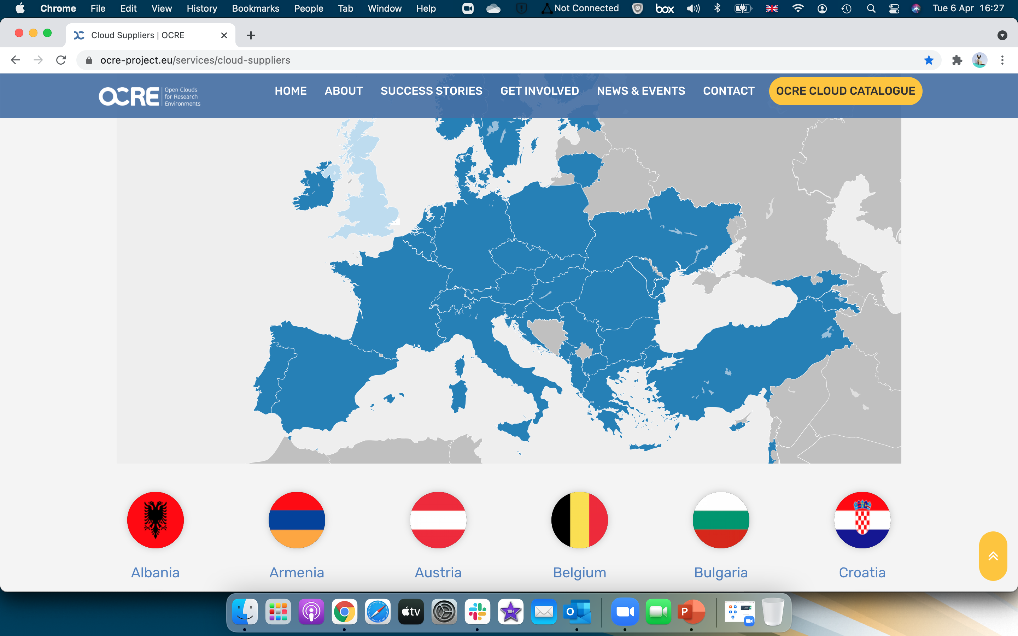
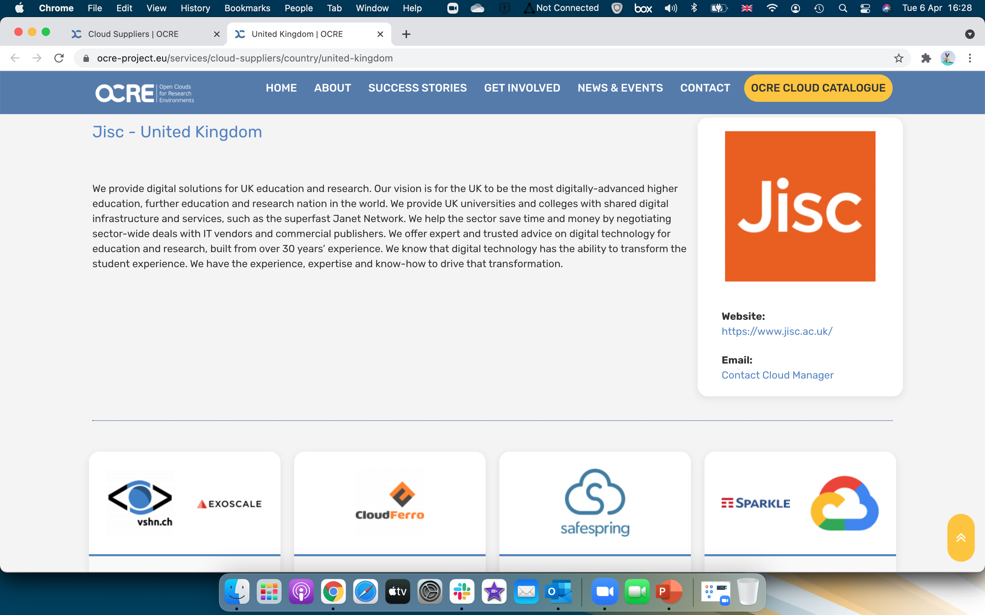

GÉANT CMG OCRE Cloud Catalogue
Catalogue consumable via API by NREN sites and EOSC portals
Supplier landing pages could host FAQs

Slide 7


GÉANT CMG Procurement
Supports call off contracts between supplier and institute
Terms and conditions signed between these two parties
Institute responsible for procurement decision and outcomes
Competition between resellers of a single platform complete
Direct award possible where supplier sole provider of specific service
CMG supported dashboard in support of mini-competitions
Contracts completely legal in terms of EU procurement directive
NREN may facilitate relationships between supplier and local R&E community
Cloud services support virtualisation of on-premise data-center (Cloud First strategy) –
Same security considerations apply to workloads (encryption etc)
Schrems II - SCCs (Standard Contractual Clauses/dual encryption still applies)
Institute must understand their own responsibilities in terms of GDPR
PaaS and SaaS available via Marketplaces (as provided by OCRE supplier)
just a procurement framework
7

Slide 8





GÉANT CMG EO Services - Tender
EO
Services
Supplier 1
Supplier 2
Supplier 3
DPS –
Documents submitted for approval
Supplier registration based on requirements identified in funding calls
Estimated 35 initial suppliers registered on DPS
i

Slide 9
GÉANT and the NRENS
Catalogue of Cloud and Digital Services
Develop relationships with market in-country
Provide access to call-off agreements
Support local cloud forums
Procure on behalf of R&E community (underwriter/Buyer Group)
Evangelize services via webinars and conferences
Host agreed upon supplier engagements
Communicate funding calls for institutes
Provide support for local buyer groups

Slide 10
Thank you
Please refer any questions to:
clouds.servicedesk@cloudteam.geant.org

